Slide 1

Sales store data analysis project
Presenter’s name :
1- Raghad Waleed
2- Kholoud Hussein
3- Menna Waleed
4- Mayar Elsayed
5- Abanoub Samy
6-Mohamed Ashraf
Date : 17/5/2025

Slide 2

Project Idea:
5/17/24
🔹 The Store Sales Data Analysis Project aims to provide a comprehensive overview of sales performance by examining order details, customer information, product categories, and shipping data. The project focuses on analyzing different aspects of the sales process to better understand store performance and identify areas for improvement.
🔹 The analysis evaluates performance across various geographic regions and compares the effectiveness of different product categories. It also explores customer behavior and purchasing patterns to uncover trends that impact overall sales.
🔹 Additionally, the project examines the impact of shipping strategies on customer satisfaction and delivery efficiency, helping identify key factors that influence sales success.
🔹 Ultimately, the project delivers data-driven insights and actionable recommendations to support informed decision-making, enhance operational performance, improve customer experience, and drive sustainable revenue growth.

Slide 3


our solution as following:
The proposed solution involves collecting and preparing sales data using Power Query for cleaning and Python for both advanced processing and data analysis. Key patterns and insights are then visualized using Power BI through interactive dashboards. This high-level approach simplifies complex information and enables non-technical stakeholders to understand performance trends and make data-driven decisions
The value proposition we add :
Our project empowers managers by providing actionable insights through data analysis, helping them make informed decisions to optimize sales performance.
The project assists management in identifying regions that require additional distribution centers and determining the most effective shipping methods, directly contributing to increased efficiency and higher sales.

Slide 4
Visualization By Power BI

Slide 5

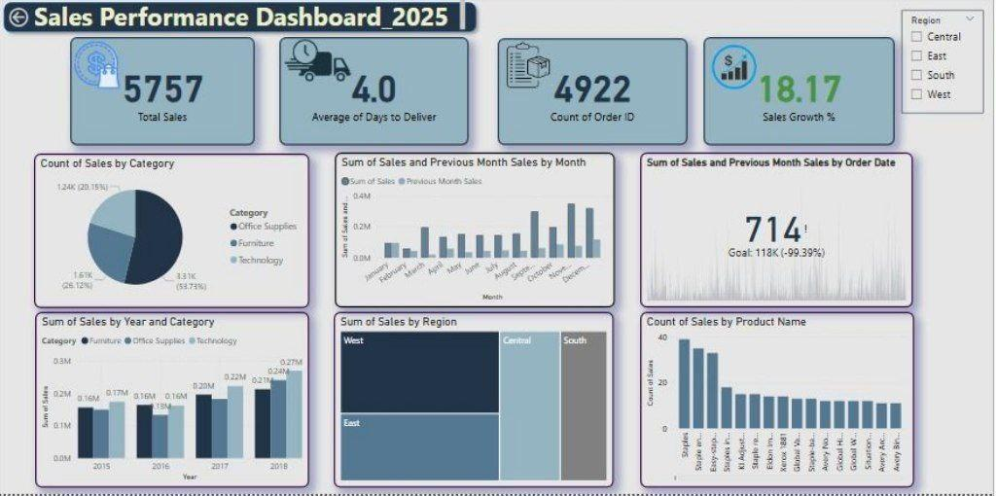
Sales performance and most important KPIs for the store .

Slide 6

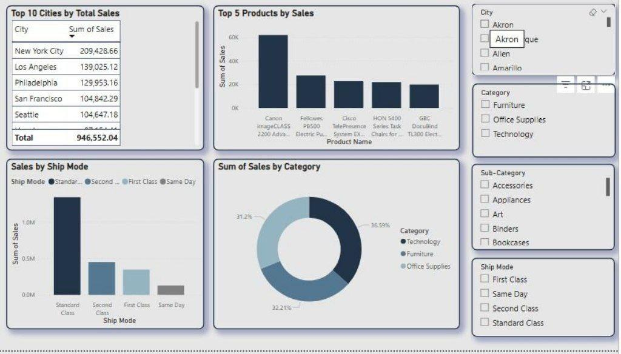
Sales by product , category cities and Ship mode

Slide 7

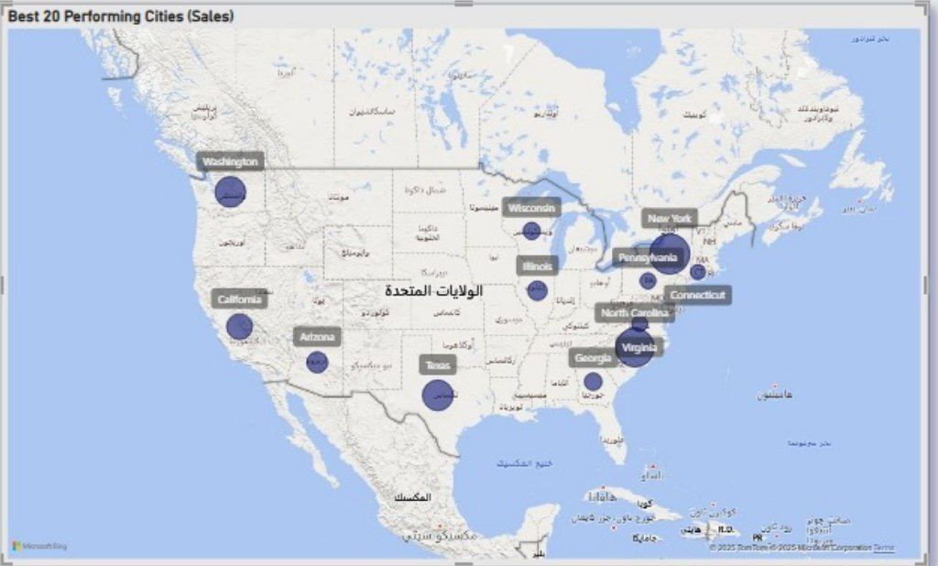
Map for the city's performance by sales

Slide 8

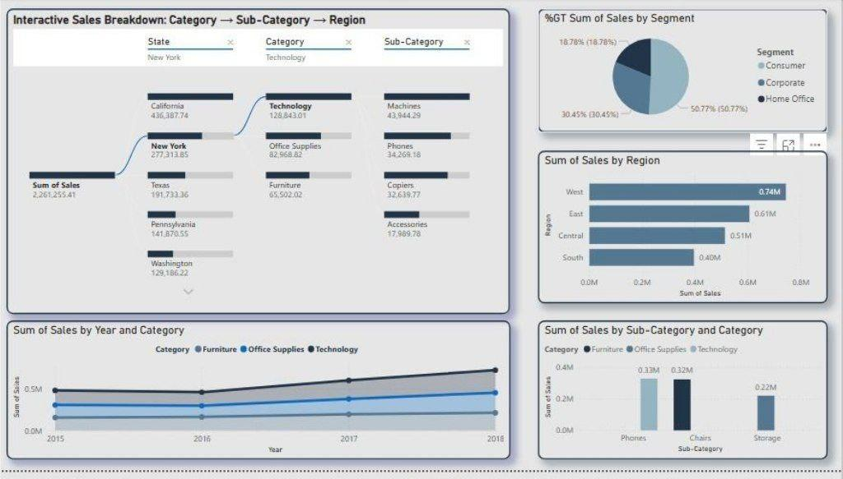
Sales for subcategory products, and sales by region and segment

Slide 9
Coding By Python

Slide 10
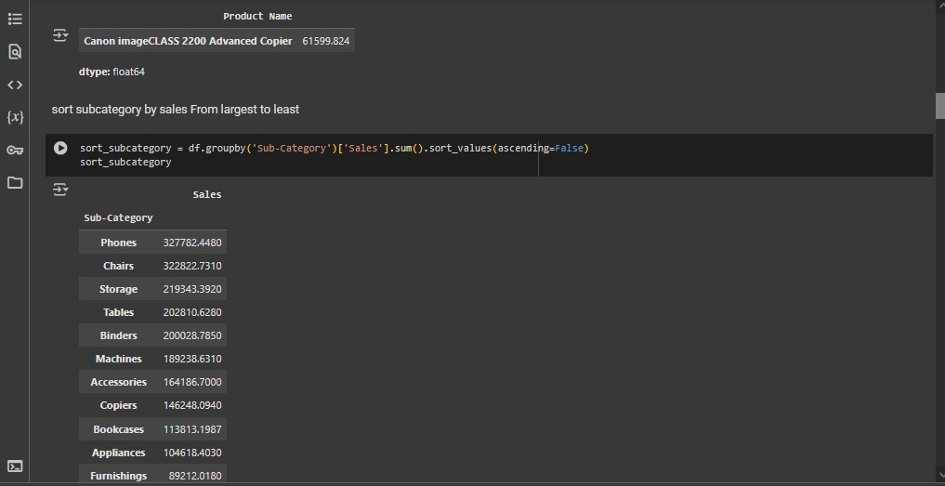
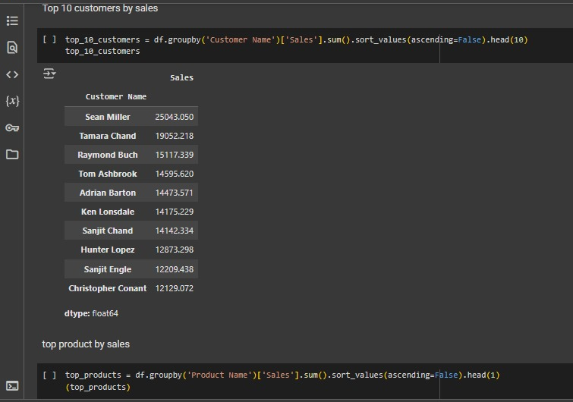
Top Insights Top 10 customers by sales Top products by sales Sort subcategory by sales descending

Slide 11
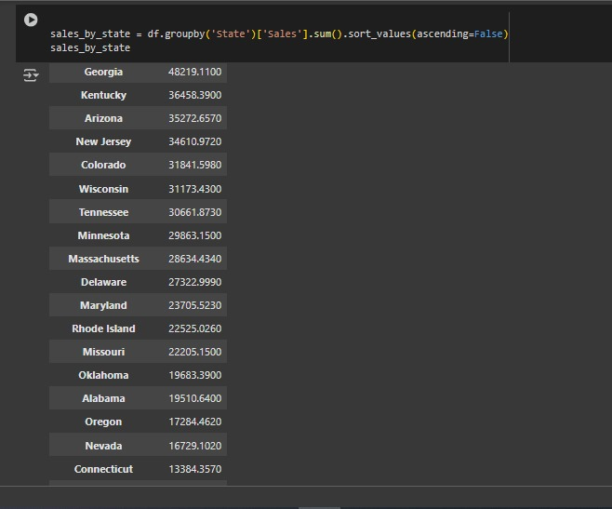
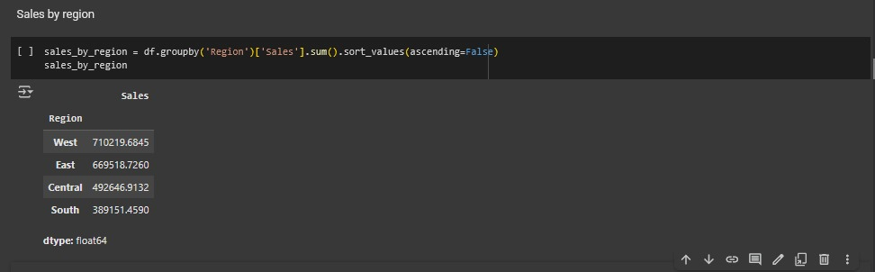
Geographical Analysis
Sales by state descending (by bandas only )
Sales by region descending (by bandas only )

Slide 12
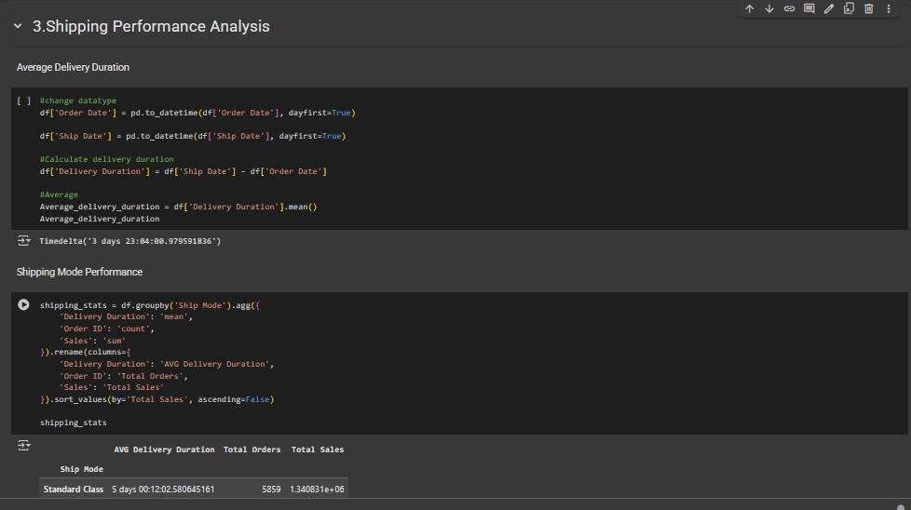
Shipping performance analysis
Average delivery duration
Shipping mode performance

Slide 13
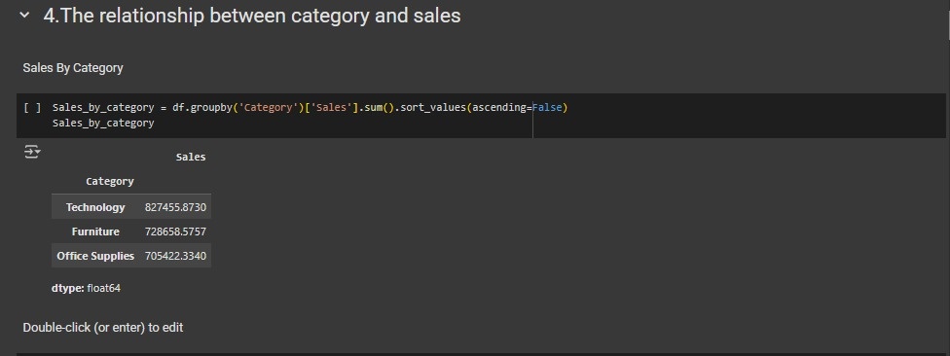
The relationship between category and sales
Sales by category descending

Slide 14
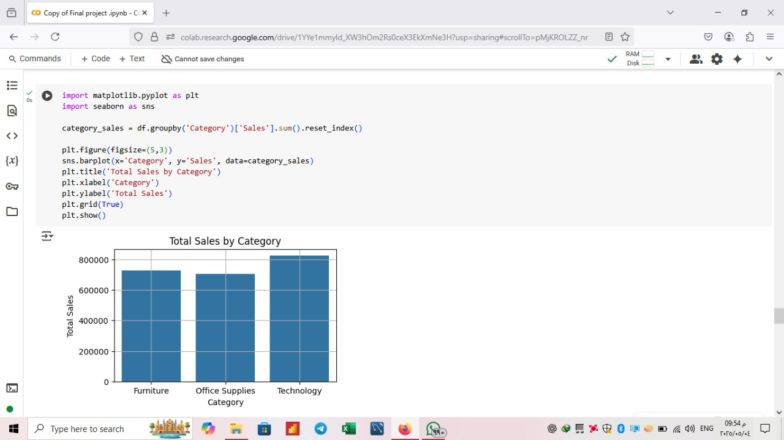
Total sales by category (furniture – office supplies – technology) technology has the highest total sales exceeding 800000

Slide 15
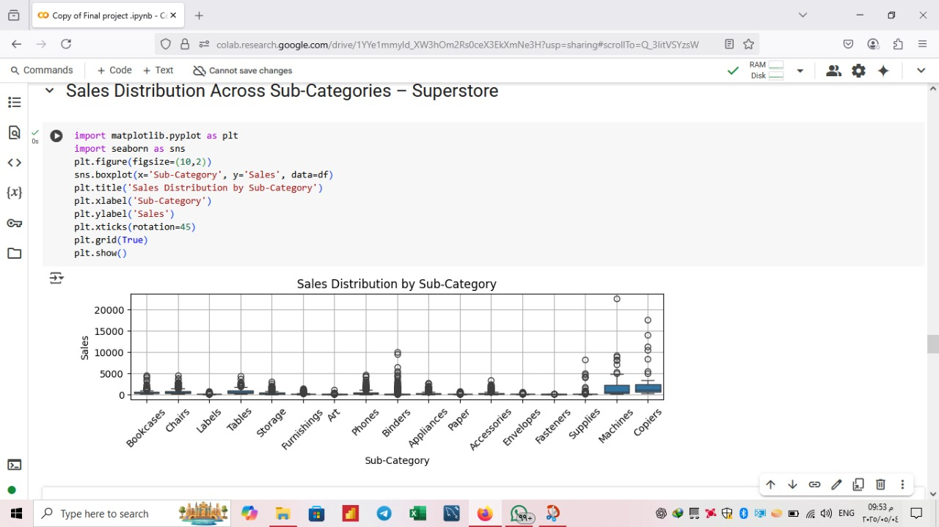
Sales distribution across sub-categories - the box itself spans the interquartile range containing the middle 50% of sales data - the line inside the box indicate the median sales value - the whisker extend to show the range of the data typically 1.5 times the IQR -Points outside the whiskers represent potential outliers

Slide 16
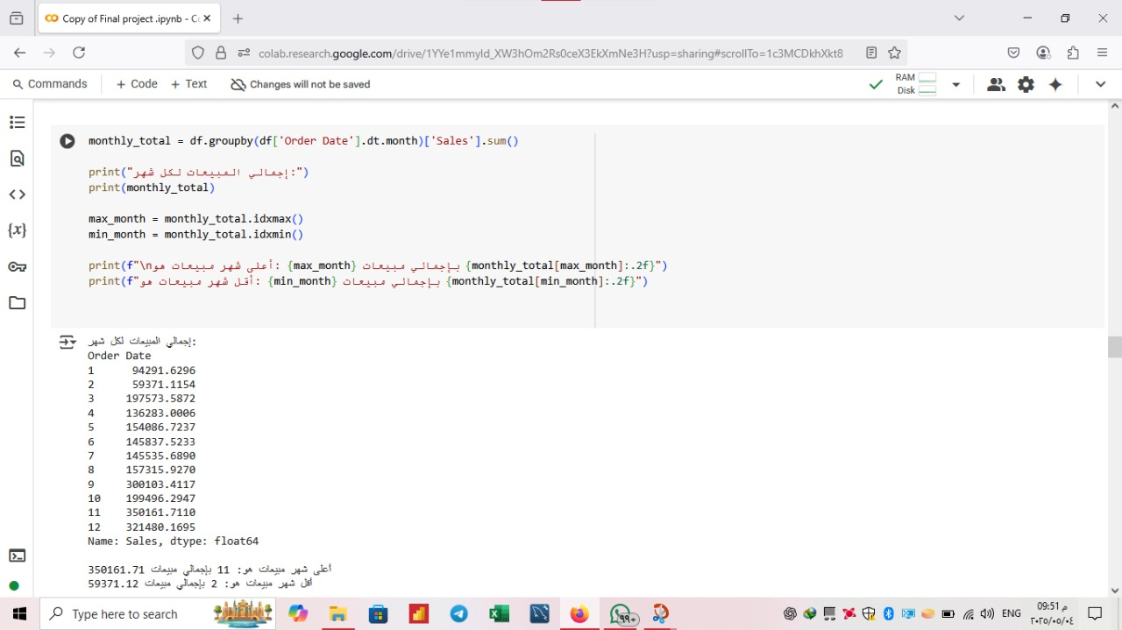
Monthly Sales Analysis Using Python Identifying the Highest and Lowest Sales Months Based on Aggregated Order Data

Slide 17
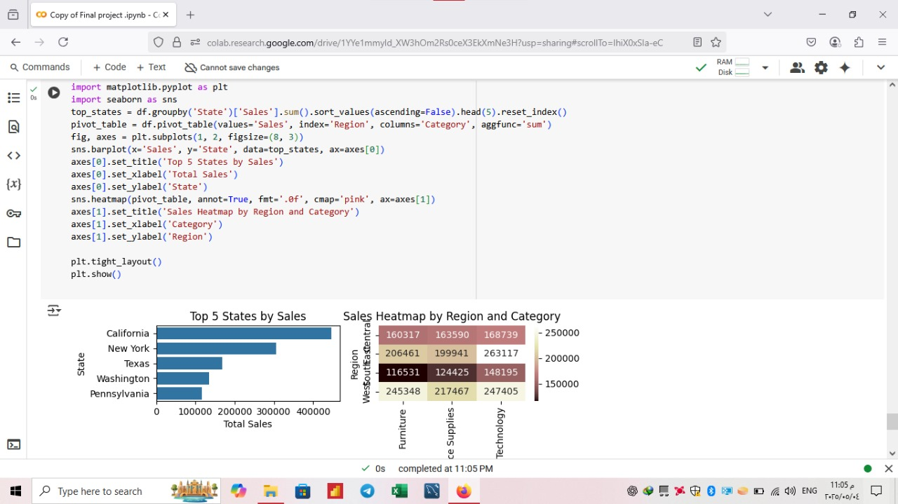
Sales Analysis by State and Region Visualizing Top 5 States by Sales and Regional Performance by Product Category Using Bar Plot and Heatmap

Slide 18

End Users + Features
🔹 Primary Users:
Managers: Need a dashboard to extract insights from raw data and develop future strategies.
Data Analysts: Need tools to analyze data and visualize performance.
Operations & Supply Chain Teams: Need insights on product demand and supplier performance.
🔹 Key Features:
Interactive Dashboard: To extract key insights and make data-driven decisions.
Product Demand Analysis: To identify high-demand products.
Sales & Supplier Analysis: To identify top sales segments and optimize distribution.
🔹 How Features Solve Problems:
Managers: Make strategic decisions based on data insights.
Data Analysts: Simplify data analysis and trend identification.
Operations Teams: Improve distribution and build supplier relationships.

Slide 19
Data Structure
🔹 Database Architecture:
The data is stored in CSV files, organized as structured documents with multiple fields. It is partially stored in the cloud and accessed both as files and tables, making it a hybrid of document-based and structured storage.
🔹 Key entities & Relationships:
Orders: includes Order ID, Order Date, Ship Date and Ship Mode.
Customers: Identified by Customer ID, linked to Customer Name and Segment.
Geographic Data: Includes Country, City, State, Postal Code and Region
Products: Described by Product ID, Category, Sub-Category, Product Name and Sales.
🔹 Data Flow:
Collection: From structured CSV files.
Storage: Stored on the cloud in both file and table formats.
Cleaning & Processing: Data is cleaned using Power Query (Power BI) and Python for further preparation and processing.
Access: Accessible via Power BI, Excel and Python notebooks.

Slide 20
Programming languages + framework:
🔹 Programming Languages:
Python: Used for data analysis, processing, and generating insights through code.
🔹 Frameworks / Tools:
Power BI: For interactive dashboards and visual representation of data.
Power Query: Used to clean and transform raw data efficiently.
Pandas (Python library): For data manipulation and analysis.
Matplotlib / Seaborn: For creating visualizations and exploring data patterns.
🔹 Supporting Technologies:
Cloud Storage: Data is stored and accessed via cloud platforms for flexibility and collaboration.
Excel: Used to preview and verify raw data when needed.
CSV Files: As the primary data source format for import and processing.

Slide 21
Live application + Test
The project was applied to real-world data and went through several testing phases which are :-
key testing activities included :
Data cleaning validation : Ensuring no missing or duplicate values
Analysis accuracy check : Verifying calculations and statistical method
User interaction test : Sharing the dashboard with users to ensure readability and usability.
Feedback was collected from :
Test users : Comments on the clarity and usability of the dashboard
Supervisor/clients : To confirm the insights match the project goal

Slide 22
Deliverables
The project include many deliverables which are :-
Final deliverables include:
Cleaned and structured excel dataset
Interactive dashboard using Power BI
Pdf report summarizing insights and recommendations
Python code for analysis.
Tools used :
Excel, Power BI, Python, (Pandas- Seaborn- Matplotlib)
Time line for submission :
Final report and dashboard delivery : 9/5/2025
Files/codes shared via google drive or GITHUB

Slide 23
Sales Data Analysis Project
Team Members : We use WhatsApp group for communication.
1- Raghad Waleed
(Team Leader)
( Data Visualization and Python)
2- Kholoud Ahmed
(Data Cleaning )
3- Menna Waleed (Data Visualization and Python)
4- Mayar Elsayed (Data Visualization)
5- Abanoub Samy (Presentation)
6-Mohamed Ashraf (Presentation)

Slide 24
For any questions or feedback…
Contact Us Via G-mail accounts :-
Raghad Waleed : raghdwaleed2004@gmail.com
Mayar Elsayed : mayarelsayed411@gmail.com
Abanoub samy : abanoubsamy351@gmail.com
Menna waleed : mennawaleed219@gmail.com
Kholud Ahmed : kholoudahmed488@gmail.com
Mohamed Haroun : mohamedharoun30215@gmail.com
Thank You

